Slide 1
Let us talk Social work
Social work is a profession which emerged during the second half of the 19th century and today is the profession charged with fulfilling the social welfare mandate of promoting well-being and quality of life. Thus social work encompasses activities directed toward improving human social conditions and alleviating human sufferings
Notes:
Profession: an occupation that requires extensive education or specialized training

Slide 2
Why Social work and Social welfare Answer these questions please

Slide 3
Do you imagine any society without human sufferings?

Slide 4
Do you think any society where all members are young and there is no old age problems?

Slide 5
All members are healthy and wealthy?

Slide 6
All members have their needs satisfied?

Slide 7
All members have equal access to facilities

Slide 8
A society where there is no drugs/ substance abuse?

Slide 9
A society where every one achieve his/her dream of career and education?

Slide 10
A society where there is no discrimination and prejudice?

Slide 11
A society where there is no mental health problems?

Slide 12
A society where there is no crimes and criminals?

Slide 13
A society where there is no poverty?

Slide 14
Yes Human societies are not perfect

Slide 15
Social problems emerge which require solutions.
Human needs must be satisfied to have a smooth running life.

Slide 16
Now answer me these questions

Slide 17
Are you offended when You see poor people picking their food from garbage dumps?

Slide 18
When you see sick people go untreated because health care is not affordable and efficient?

Slide 19
When you see children addicted
to drugs

Slide 20
They beg in streets

Slide 21
Do not go to schools being poor.

Slide 22
Abused sexually and physically

Slide 23
When You See Violence In The Families

Slide 24
Do You Want To Be involved in shaping A society that strives to ensure high quality
of life?

Slide 25
if your answer is yes

Slide 26
Then welcome to the profession of
social work
and
social welfare

Slide 27
Now tell me who are Social workers?
Professional helpers designated by society to aid people who are
distressed,
disadvantaged,
disabled
deviant,
defeated or
dependent.

Slide 28
They also help people lessen their chances of being
poor,
inept,
neglected,
abused,
divorced,
delinquent,
criminal,
alienated, or
mad

Slide 29
What is social work?

Slide 30
Definition of Social Work
Social Work is a professional activity that aims to assist people in overcoming serious difficulties in their lives by offering care, protection and counselling.
C. Hanry and Philpot. (1994). Practicing Social Work. London: Rutledge.

Slide 31
Social work is the professional activity of helping individuals, groups, and communities to enhance or restore their capacity for social functioning and to create societal conditions favourable to their goals.
( National Association of social workers USA).

Slide 32
Definition by IFSW and IFSSW.
Social Work profession promote social change, problems-solving in human relationships & the empowerment and libration of people to enhance well-being.
Utilizing theories of human behaviour and social system, social work intervenes (مداخلت) at the point where people interact with their environment.
Principles of human rights and social justice are fundamental to social work.
IFSW and IFSSW. (2000). International Journal of Social Work. Vol: 47-3. pp-407-424.

Slide 33
Social Work Profession
Promote
Social Change
Problem-Solving in Human Relationships
Problems
Enhance
Well-being
Liberation
Empowerment
People
Notes:
Social, Economic, Psychological, Spiritual, and Medical State of being good.

Slide 34
Social, Economic, Psychological, Spiritual, and Medical State of being good

Slide 35
Utilizing Theories
Theory is an Explanation of Facts
Human Behaviour
Social System
i.e.
i.e.
Psychology
Sociology
Intervention
Where people interact with their environment

Slide 36
Interaction
Inter
Action
+
=
Interaction
Between, Among, Mutual
Activity
Activity between two people or objects (or any of two things)

Slide 37
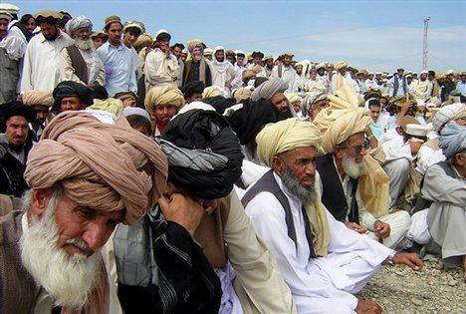
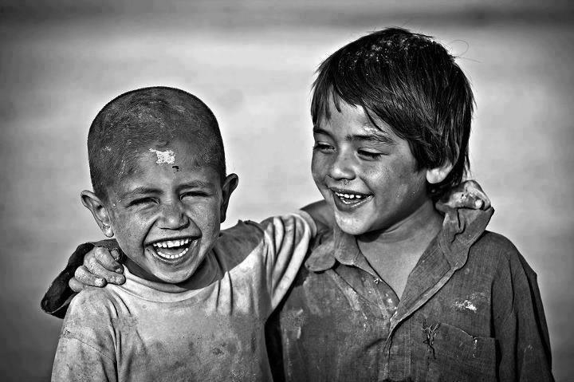
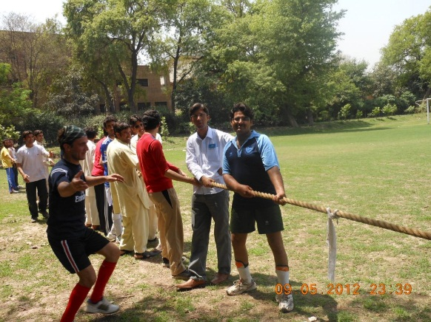
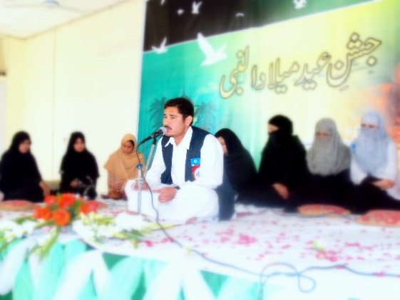
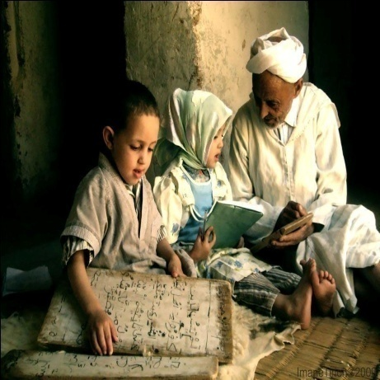
Examples of INTERACTION

Slide 38
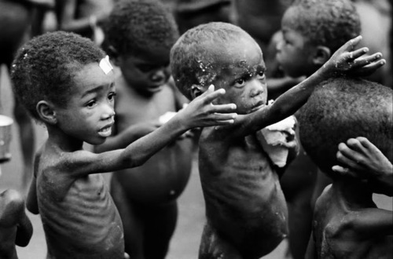
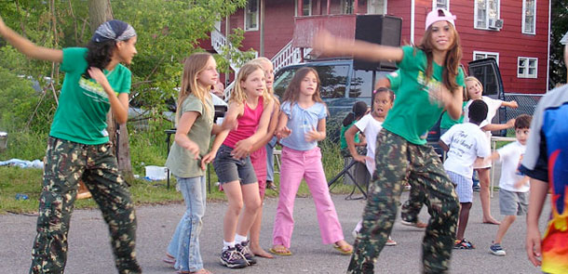
Fundamental Principles
Human Rights
Social Justice

Slide 39
Social work defined
Very simply we can say
Social work is a helping profession to help people overcome their problems.
Social Work is helping people to help themselves.

Slide 40
Knowledge-base of social work
From the definition of IASSW it is clear that SW has borrowed its knowledge base from a variety of subjects like Psychology, sociology, psychiatry, biology, economics, political science etc .
Thus there is a relationship between SW and these subject as below

Slide 41
Social
Work
profession
Psychology:-
The scientific study of Mind and
behaviour
Sociology:-The organized
study of how groups develops
interact, behave and
Function within the society
Micro practice
(Individuals)
Pol. Science: The study of pol.
& govt. structures& Functioning
Micro/mezzo
Practice
(Families)
Economics ’;The study of the
Production, distribution &con-
sumption of goods & services
Mezzo Practice
(Groups)
Biology;-The study of living
organisms and their physical
Functions.
Macro practice
Organizations and Communities
Psychiatry;-the diagnosis &
treatment of mental, emotional
& behavioral disorders
Anthropology;-the study of
human culture specially
Its history, social structure, language
And technology
Social work;-The practical application of knowledge,
skills and values to enhance the well –Being of inds.,
gps, orgns. and communities
Notes:
The social work knowledge base

Slide 42
Education for the profession requires foundational understanding of human needs, social problems, social welfare responses, consumers of social services, and professional intervention.

